Slide 1
Multi-Objective Optimization Using Membrane Inspired Evolutionary Algorithm
Department of Electronics and Computer Engineering
Institute of Engineering, Pulchowk Campus, TU, Nepal
MSc in Computer System and Knowledge Engineering Program
Student:
Bishwo Prasad Lamichhane (070MSCS655)
Department of Electronics and Computer Engineering,
IOE Pulchowk Campus, TU
Supervisor:
Sanjeeb Prasad Pandey, Ph.D.
Department of Electronics and Computer Engineering,
IOE Pulchowk Campus, TU
Date: April, 2023

Slide 2
Outline
Introduction
Statement of the Problem
Objectives
Literature Review
Methodology
Results
Conclusions and future works
Thesis Timeline

Slide 3
Introduction
The goal of this research is to use the computational model proposed by Membrane Computing to
  solve multi-objective optimization problems (MOOPs) and
  compare quality of solutions and performance with standard multi-objective optimization algorithms.
Standard test functions for multi-objective optimization is used
  to develop the algorithm and
  to compare quality of solutions and performance.

Slide 4
Statement of the Problem
Current bio-inspired multi-objective optimization algorithms
  start with random candidates/population across the entire decision space
  perform some fitness evaluations, and
  create next generation of population using features of candidates with better fitness values.
Partitioning of decision space into hyper volumes can
  enable parallel execution of evolutionary steps resulting faster convergence
  computing model proposed by membrane computing can be utilized to achieve that goal

Slide 5
Statement of the Problem (contd.)
The offspring generation process involves selecting
  parent populations based on fitness value and other parameters
  parents can come from different regions of the decision space
  which may have differently shaped optimum spaces
Partitioning the decision space and performing evolutionary steps within regions
  results in better offspring
  reduces the number of generations needed to achieve results closer to the true Pareto-Front.

Slide 6
Objectives
To create evolutionary algorithm
  capable of solving multi-objective optimization problem by,
  utilizing computational model proposed by membrane computing.
Analyze the performance of developed algorithm with following benchmark MOOP functions
  Zitzler–Deb–Thiele’s Function 1 (ZDT1)
  Zitzler–Deb–Thiele’s Function 2 (ZDT2)
  Zitzler–Deb–Thiele’s Function 3 (ZDT3)
Compare the performance of developed algorithm with following standard MOOP solving algorithms with following metrics
  Generational Distance (GD)
  Inverted Generational Distance (IGD)

Slide 7
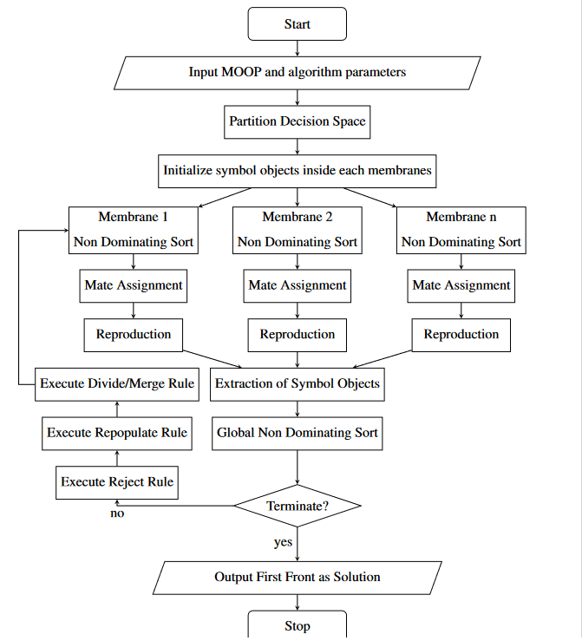
Methodology - Flowchart
Following are the steps of algorithm :
Partitioning of decision space
Initialization
Non-dominating sort inside membrane
Mate Assignment
Reproduction
Global non-dominating sort
Reject Rule
Repopulate Rule
Divide and Merge Rule

Slide 8
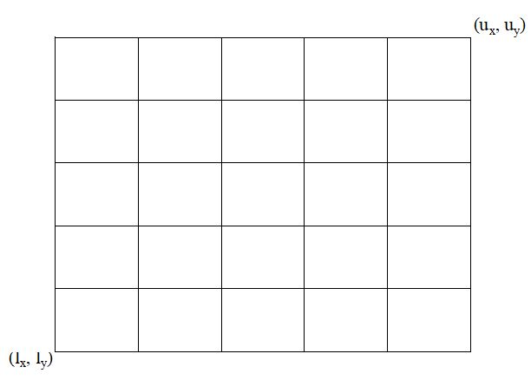

Partitioning of decision space
For an optimization problem with
  d number of decision variables and
  n number of partitions per dimension;
  total number of membranes will be $n^{d}$.
The figure represents a two dimensional
decision space with 5 partitions per
dimension so that number of partitions
will be $5^{2}=25$.
l_{x} , l_{y} are the lower bound and
u_{x} , u_{y} are upper bound for the
decision variables x and y

Slide 9
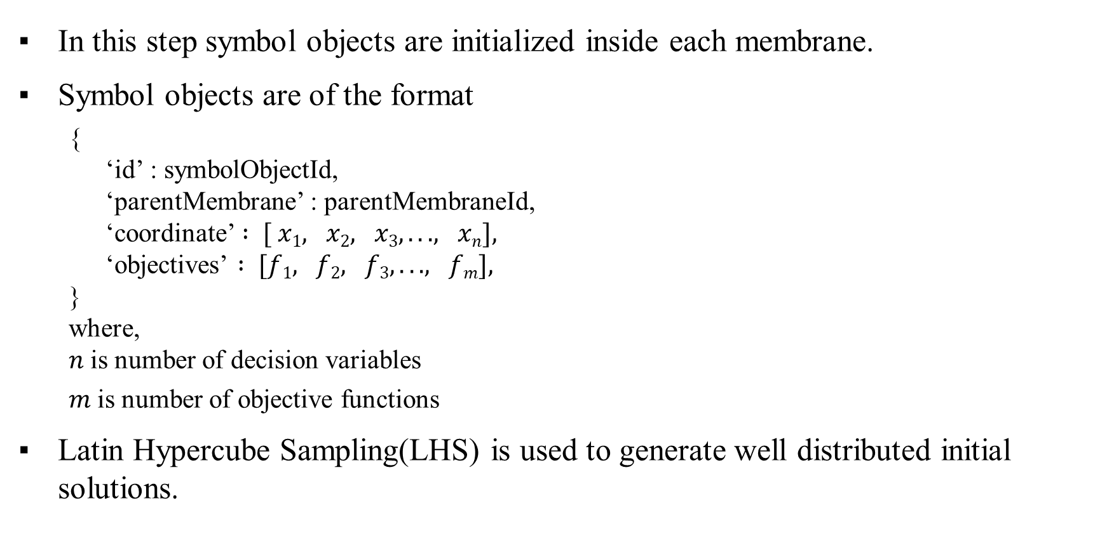
Initialization
In this step symbol objects are initialized inside each membrane.
Symbol objects are of the format
  {
  ‘id’ : symbolObjectId,
  ‘parentMembrane’ : parentMembraneId,
  ‘coordinate’ $: [ x1, x2, x3, . . . , xn],$
  ‘objectives’ $: [f1, f2, f3, . . . , fm],$
  }
  where,
  $n$is number of decision variables
  $m$is number of objective functions
Latin Hypercube Sampling(LHS) is used to generate well distributed initial solutions.

Slide 10
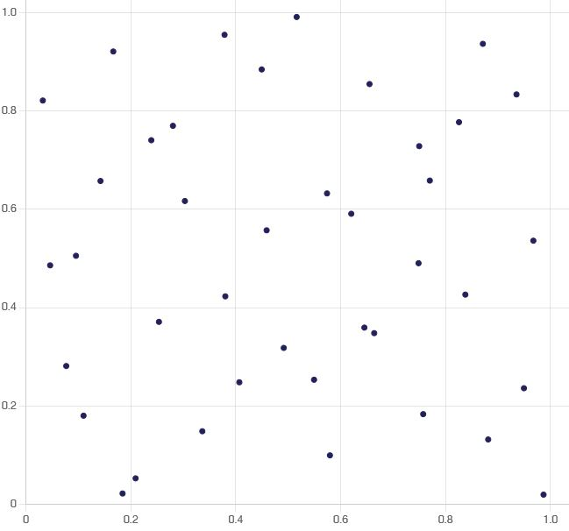
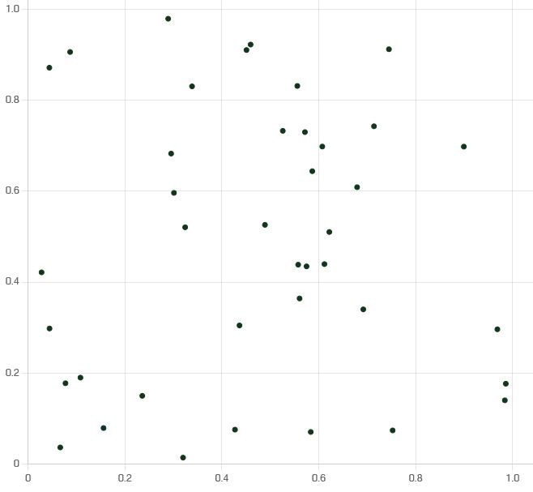
Initialization (contd.)
Latin Hypercube Sampling
Random Sampling

Slide 11
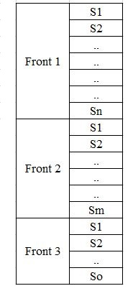
Non-dominating sort inside membrane
Non-dominating sort is performed inside each membrane.
Each membrane will have its own Pareto fronts.
The figure shows an example of Pareto fronts inside
each membrane.
This step is independent of the operations within
other partitions so has been done in parallel

Slide 12
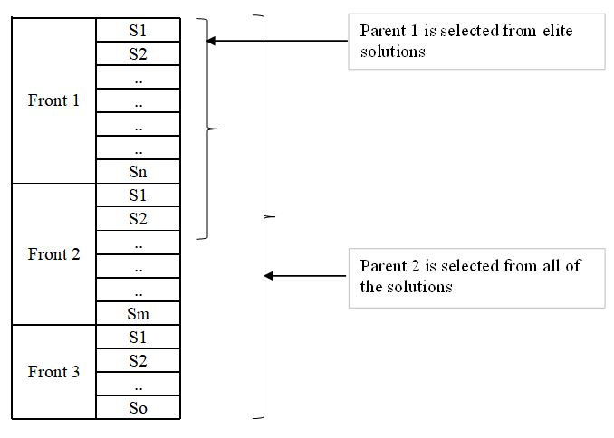
Mate Assignment
Sorted symbol objects are divided into two parts
  elite solutions and
  non-elite solutions.
A parent pair is generated by selecting
  one from the elite solutions and
  one from all of the solutions
  (except the first parent).
Mate assignment process is executed in
all membranes.
Mate selection process in repeated until
number of pairs are equal to number of
symbol objects.

Slide 13
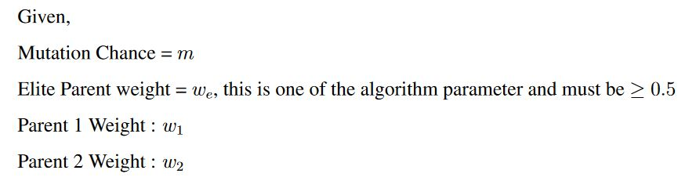
Reproduction
An offspring is created by combining the features of parent pair
  If one of the parent is dominating other the offspring gets more characteristics from dominating parent.
  Otherwise offspring gets equal characteristics from both parents.
Small mutation is also introduced into offspring.
To generate next generation of symbol objects :

Slide 14
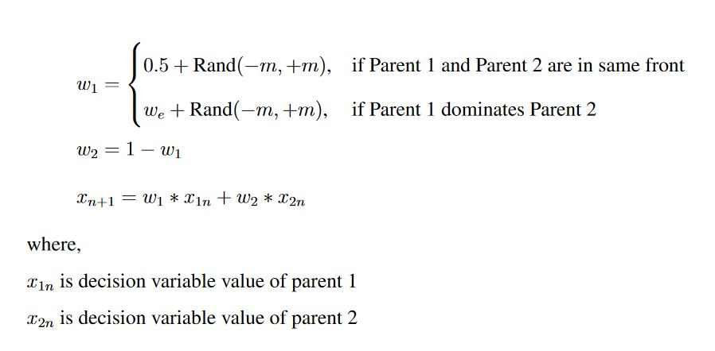
Reproduction
Then

Slide 15
Global non-dominating sort
A non-dominating sort of all of the symbol objects is performed.
First pareto front of this step contains the best solutions up to this iteration.
Optimization can be stopped at this stage if termination condition is met.

Slide 16
Reject and Repopulate Rule
In this step half of the low ranking solutions (solution in higher fronts) are rejected.
If a front is being partially rejected, then symbol objects in this front are rejected in such a manner such that
  Every membrane gets similar number of symbol objects as much as possible.
  This will ensure diversity of solutions.
Accepted symbol objects are sent into their corresponding parent membranes.

Slide 17
Divide and Merge Rule
Membranes may contain more or less symbol objects than at the start.
  If a membrane contains more symbol objects, a division rule is applied to it.
  If a membrane contains less symbol objects, it is merged with its neighbor.
The division threshold is set at 150%, while the merge threshold is set at 50%.
At the end of this step,
  the number of membranes and symbol objects are the same as at initialization, but
  the number of symbol objects inside each membrane is between the 50% and 150%
A membrane is divided into two partitions,
  by assigning symbol objects to the new membranes and
  dividing them equally between elite and non-elite solutions

Slide 18

Divide and Merge Rule (contd.)
At the end of this step number of membranes and number of symbol objects are same as they are at the initialization step.
But number of symbol objects inside are between $50\%$to $150\%$.
Repeat from "Non-dominating sort inside membrane" step until termination condition is reached.

Slide 19

Performance Indicators
At the end of this step number of membranes and number of symbol objects are same as they are at the initialization step.
But number of symbol objects inside are between $50\%$to $150\%$.
Repeat from "Non-dominating sort inside membrane" step until termination condition is reached.

Slide 20
Output
Implementation of the algorithm is done in PHP 8.2 programming language.
A testing application is also created to check the performance of algorithm with different parameters.
Program for
  visualization of solutions in decision space,
  visualization of objective values in objective space and
  visualization of pareto fronts from stored details of algorithm execution
  is also created.
Performance metrics are calculated with open source “pymoo” package written in Python language.

Slide 21
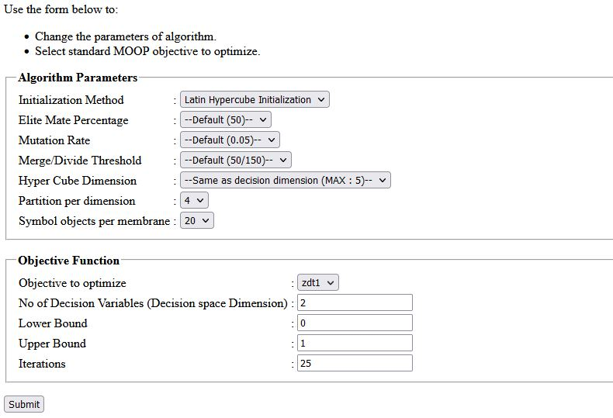
Output – Algorithm Test Application

Slide 22
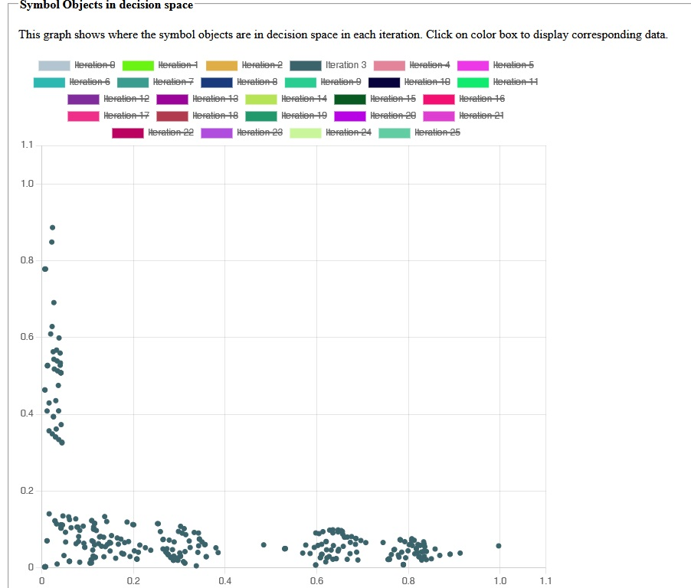
Output – Symbol Object Visualization

Slide 23
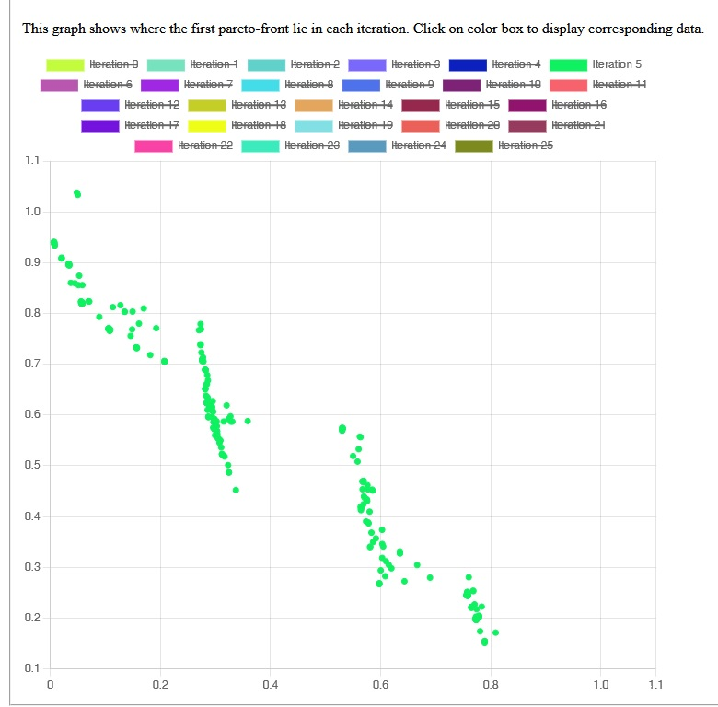
Output – Objective Visualization

Slide 24
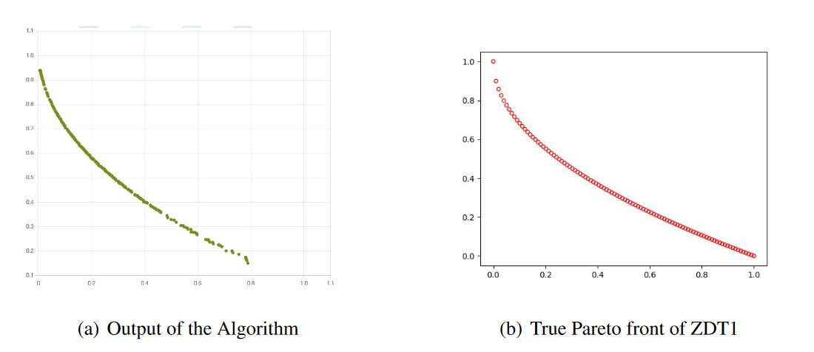
Output (contd.)
The algorithm is producing satisfactory results with ZDT1, ZDT2 and ZDT3 objectives.

Slide 25
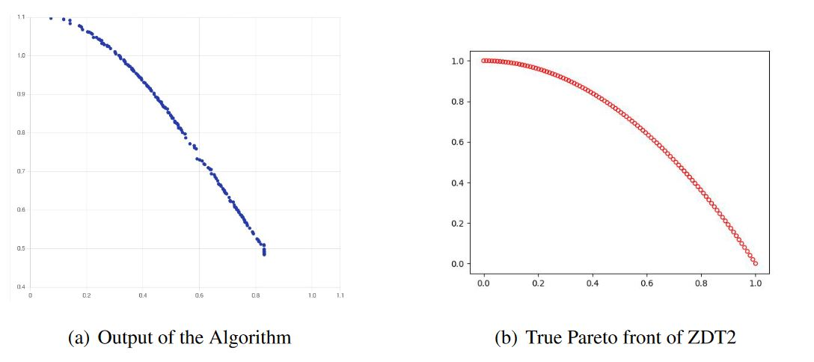
Output (contd.)

Slide 26
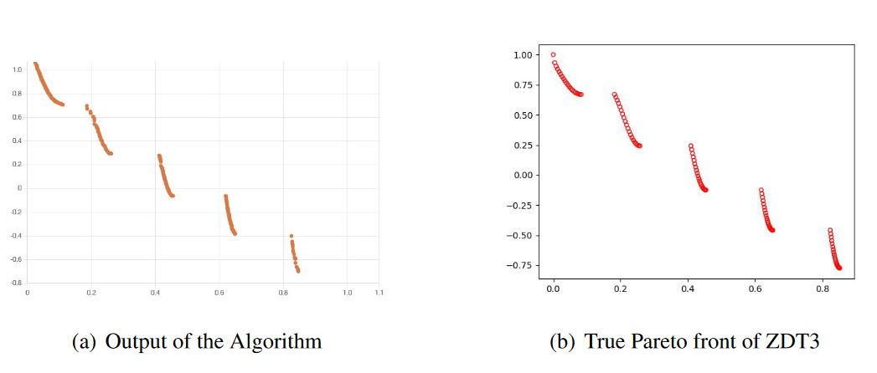
Output (contd.)

Slide 27
Results – Experimental Setup
All of the
  programming,
  testing,
  debugging,
  execution and
  benchmarking of MOOP solving algorithms
are done in computer setup with:
  Intel Core I5 5200U processor (2 physical cores)
  8 GB of DDR3 RAM
  Windows 10 pro operating system

Slide 28
Results – Changing Problem Complexity
Setup :
  Problem : ZDT1
  Number of partitions : 4
  Symbol objects per partition : 32
  Number of iterations : 50
  Number of executions : 20
SN | Dimension | Performance Indicators
 |  | GD |  |  |  | IGD
 |  | Best | Worst | Mean | Std. Dev. | Best | Worst | Mean | Std. Dev.
1 | 2 | 3.54E-03 | 1.51E-02 | 7.18E-03 | 2.67E-03 | 3.48E-03 | 1.15E-02 | 6.36E-03 | 1.91E-03
2 | 3 | 1.60E-02 | 5.82E-02 | 3.51E-02 | 1.10E-02 | 1.49E-02 | 5.77E-02 | 3.45E-02 | 1.11E-02
3 | 4 | 4.37E-02 | 8.48E-02 | 6.89E-02 | 1.22E-02 | 4.18E-02 | 8.46E-02 | 6.83E-02 | 1.24E-02

Slide 29
Results – Comparison with standard MOOP algorithms
To compare the performance of proposed algorithm with NSGA-II and MOEA/D following parameters are used
Parameters for membrane inspired algorithm
  No. of partitions per dimension = 4
  No. of symbol objects per partition = 32
  Mutation chance = 0.05
Parameters for NSGA-II
  Population size = 512
Parameters for MOEA/D
  Sub-problems: N = 512,
  Number of neighbors: T = 10
  The probability of selecting parents from the neighbors = 0.9
  Mutation rate: C R = F = 0.5

Slide 30
Results – Comparison with standard MOOP algorithms
GD | Mem. Algorithm | NSGA II | MOEA/D
ZDT1
Best | 3.05E-03 | 4.69E-03 | 4.44E-03
Worst | 1.02E-02 | 7.54E-03 | 7.13E-03
Mean | 6.32E-03 | 6.31E-03 | 5.97E-03
Std. Dev. | 1.86E-03 | 8.84E-04 | 8.38E-04
ZDT2
Best | 6.18E-03 | 5.19E-03 | 4.38E-03
Worst | 2.39E-02 | 8.10E-03 | 8.16E-03
Mean | 1.50E-02 | 6.85E-03 | 6.32E-03
Std. Dev. | 4.89E-03 | 7.43E-04 | 8.37E-04
ZDT3
Best | 2.08E-03 | 5.21E-03 | 4.72E-03
Worst | 1.76E-02 | 7.57E-03 | 7.46E-03
Mean | 9.79E-03 | 6.36E-03 | 5.95E-03
Std. Dev. | 4.45E-03 | 7.54E-04 | 8.68E-04
IGD | Mem. Algorithm | NSGA II | MOEA/D
ZDT1
Best | 2.65E-03 | 1.27E-03 | 2.65E-04
Worst | 8.76E-03 | 3.79E-03 | 4.03E-03
Mean | 5.94E-03 | 2.71E-03 | 2.19E-03
Std. Dev. | 1.66E-03 | 7.94E-04 | 8.99E-04
ZDT2
Best | 6.14E-03 | 3.71E-03 | 3.02E-03
Worst | 2.37E-02 | 6.66E-03 | 6.31E-03
Mean | 1.46E-02 | 5.09E-03 | 4.64E-03
Std. Dev. | 4.68E-03 | 9.32E-04 | 9.77E-04
ZDT3
Best | 1.39E-03 | 6.15E-04 | 2.65E-04
Worst | 1.74E-02 | 3.43E-03 | 3.07E-03
Mean | 9.60E-03 | 1.97E-03 | 1.55E-03
Std. Dev. | 4.54E-03 | 8.47E-04 | 8.35E-04

Slide 31
Conclusion
The algorithm presented in this thesis was able to generate results that are closer to standard MOOP algorithms.
In some cases, the proposed algorithm performed better than the standard MOOP solvers.
However,
  the mean and
  standard deviation values of IGD (inverted generational distance)
  generated by the proposed algorithm are still worse than other algorithms, indicating a larger variance in the output generated.

Slide 32
Future Works
Incorporating several concepts from membrane computing model can improve the quality of solutions.
To adapt the algorithm for higher dimensions of the decision space, the additive nature of MOOP can be utilized, as presented in (H. Wang et al. 2022) [17].
Candidates who fail in the mating selection stage can be
  agitated using the Brownian motion method,
  as suggested in K. Sowjanya (et al. 2021)[18], to better utilize the population.
Finally, this algorithm can be adapted to solve multi-objective integer and mixed-integer programming problems using the hybrid approach proposed in (R. S. Burachi et al. 2021) [19].

Slide 33
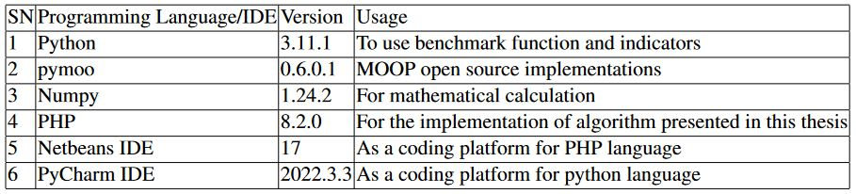
Tools

Slide 34
Queries/Comments/Feedback?
Thank You !

